Slide 1



PEILab Group Meeting

Slide 2
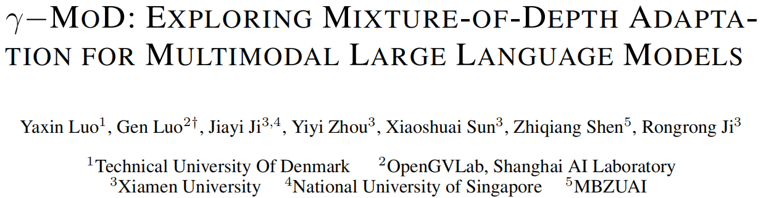
γ−MOD
ICLR’25

Slide 3
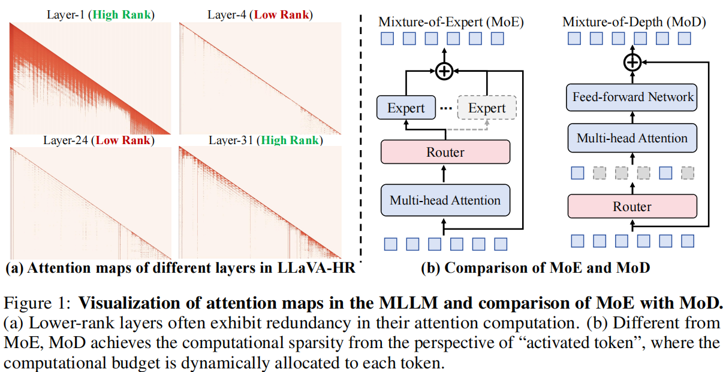
γ−MOD
Motivation
Despite the significant progress in multimodal large language models (MLLMs), their high computational cost remains a barrier to real-world deployment.
As shown in Fig. 1 (a), a large number of tokens are less important in the
computation, such as visual background and prepositional words.

Slide 4
γ−MOD
A promising solution to this issue is the recently proposed mixture-of-depths (MoDs) in NLP , which equips each token with a router to determine whether a module should be computed. However, recent MoDs typically require pre-training LLMs from scratch, and their employment on MLLMs still remains under-explored.
Challenge
However, directly converting all dense layers of MLLMs to MoD layers leads to significant performance degradation.
Reasons: Firstly, the deployment of
MoDs lacks a practical guidance to measure the layer redundancy, thus undermining the necessary dense layers. As illustrated in Fig. 1 (a), attention patterns vary significantly across layers, and some layers exhibit less redundancy. Additionally, the setting of MLLMs, e.g., input modality, differs
substantially from that of LLMs, making the direct adaptation of MoDs suboptimal.

Slide 5
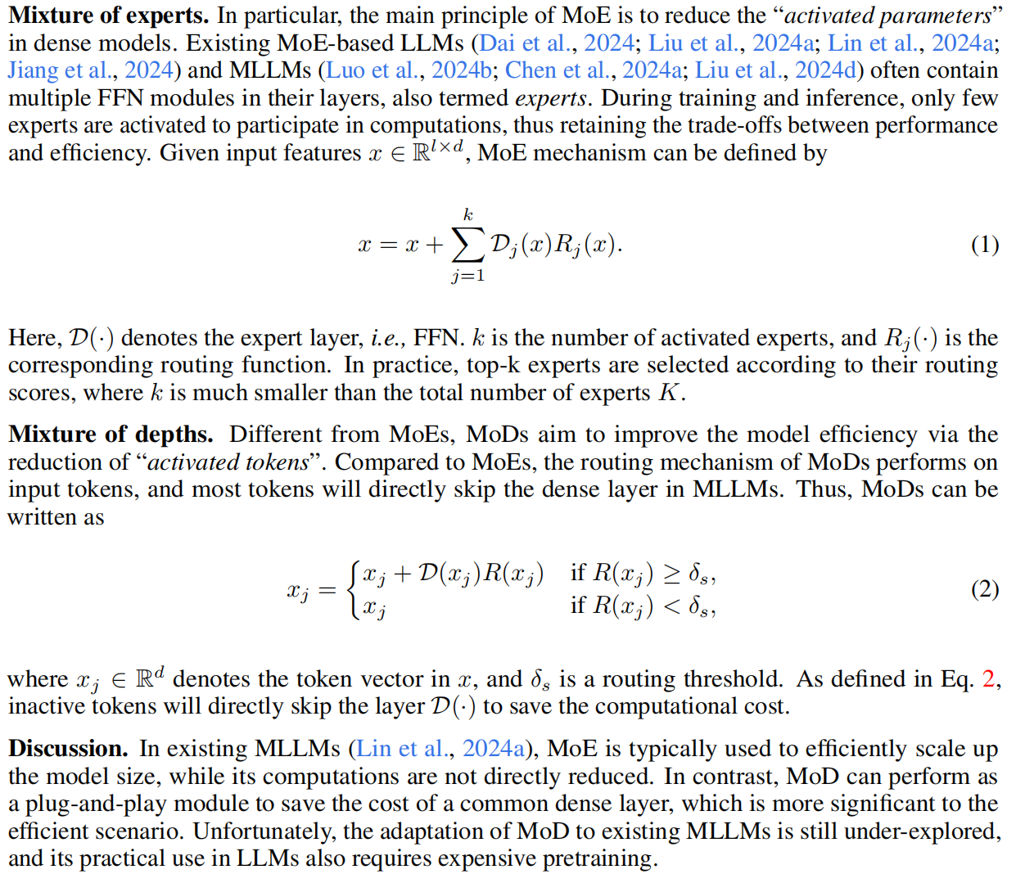
γ−MOD
MoE vs MoD

Slide 6
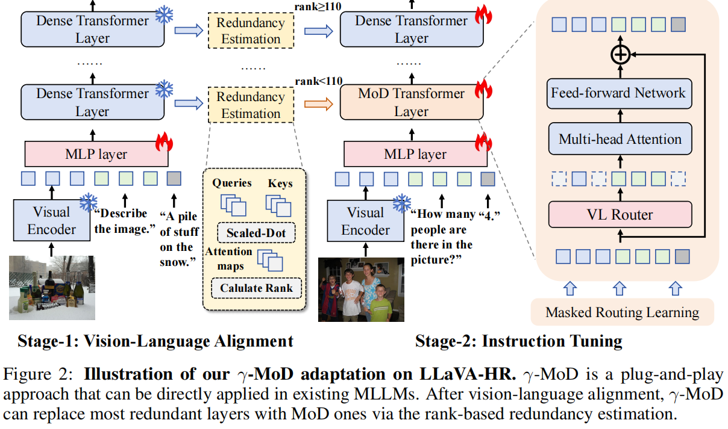
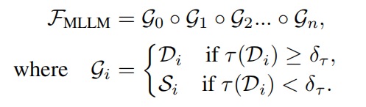
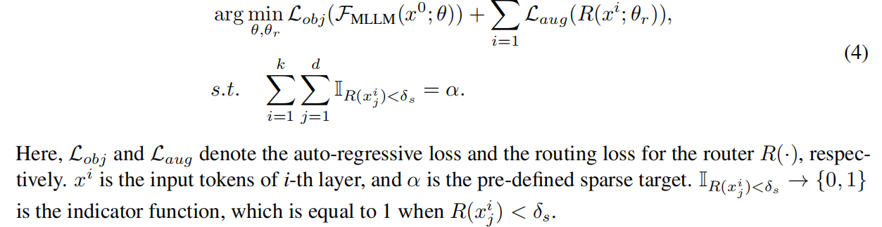
γ−MOD
Overview
Formulation:
Optimization Objective:

Slide 7
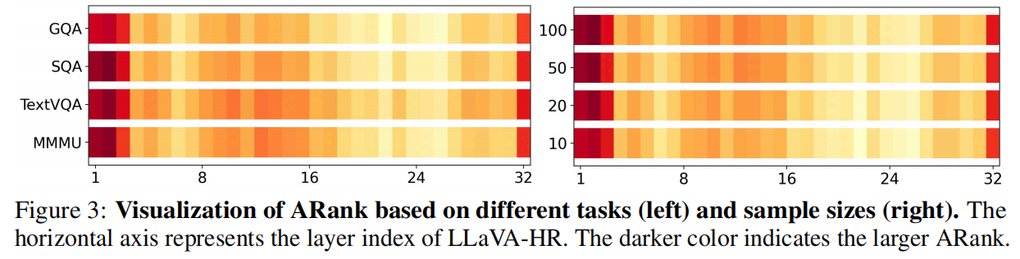
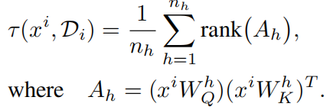
γ−MOD
RANK-BASED REDUNDANCY ESTIMATION
The key challenge of γ-MoD is how to identify the dense layer that should be converted to the MoD one. In practice, directly replacing all layers with MoD ones will lead to significant performance degeneration. The original MoD-based LLM overcomes this issue by the hand-craft attempt, which is still sub-optimal and time-consuming.
However, in existing MLLMs, the LLM is already pre-trained on large scale of corpus, which can intuitively provide sufficient knowledge to achieve the process automatically.
The core principle of γ-MoD is to identify redundant MLLM layers via a novel metric called rank of attention maps (ARank)
The expected ARank remains largely consistent across different tasks.

Slide 8
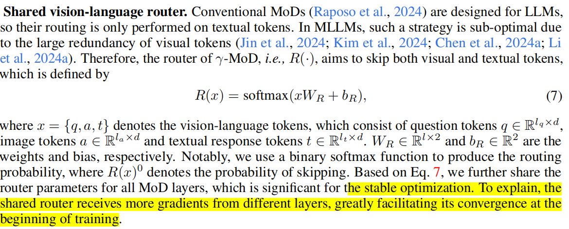
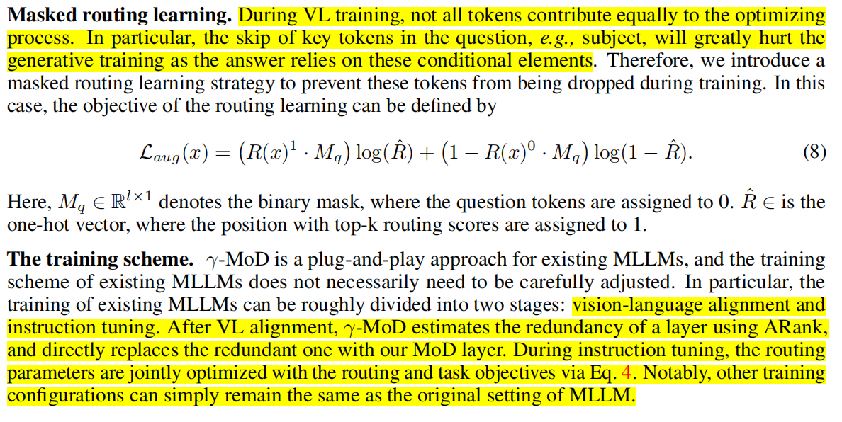
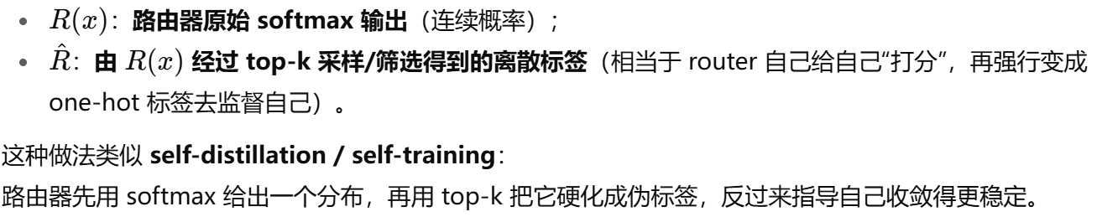
γ−MOD
MIXTURE-OF-DEPTH ADAPTATION
equation 8直观解释：对于被 mask 标注为关键的 token（例如 question），强制 router 把它们标为“保留”；对于其它 token，允许 router 自主选择（由 top-k 伪标签确定）。训练时把 routing loss 与语言模型目标一并优化

Slide 9
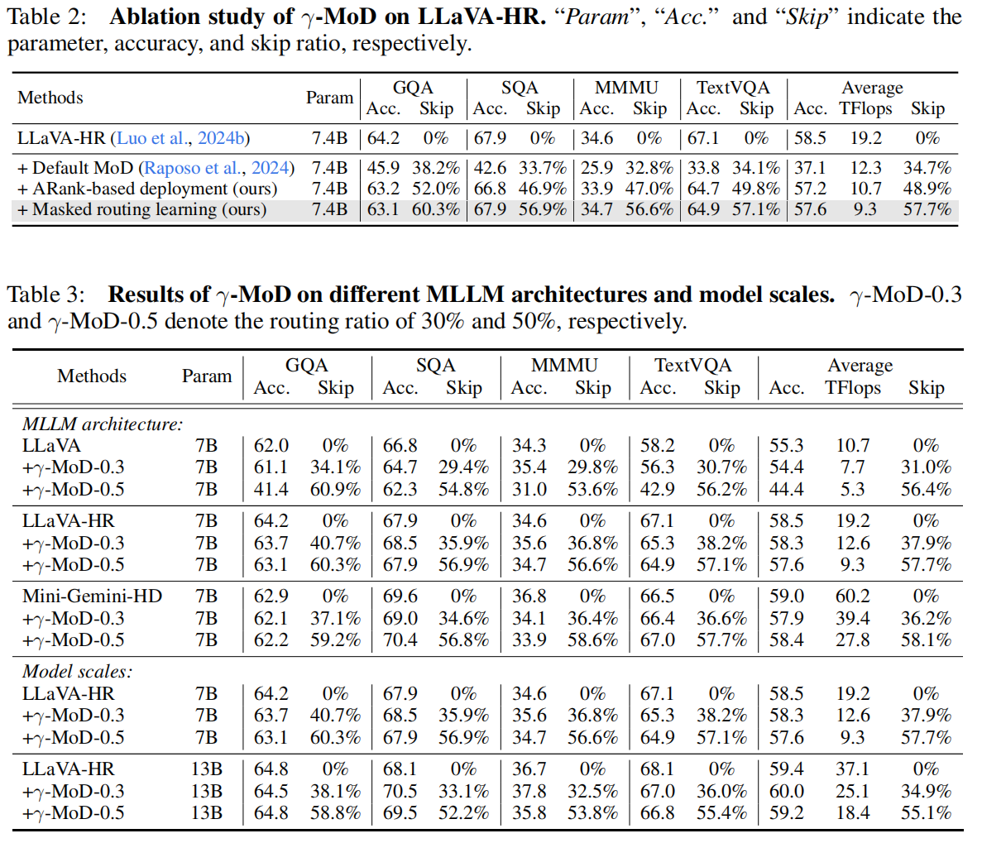
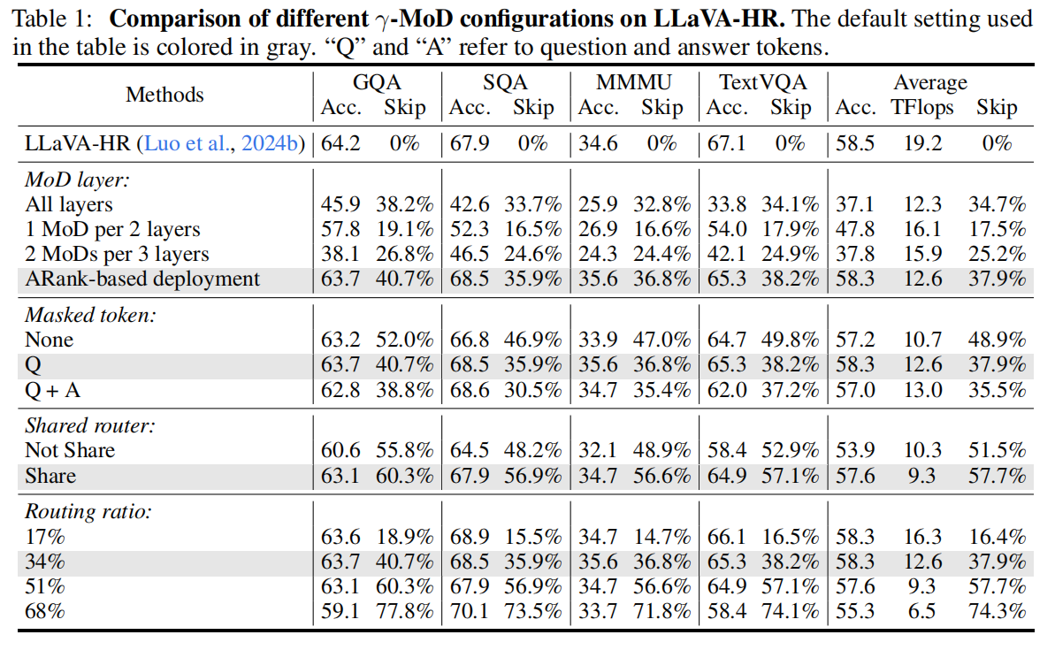
γ−MOD
Results

Slide 10
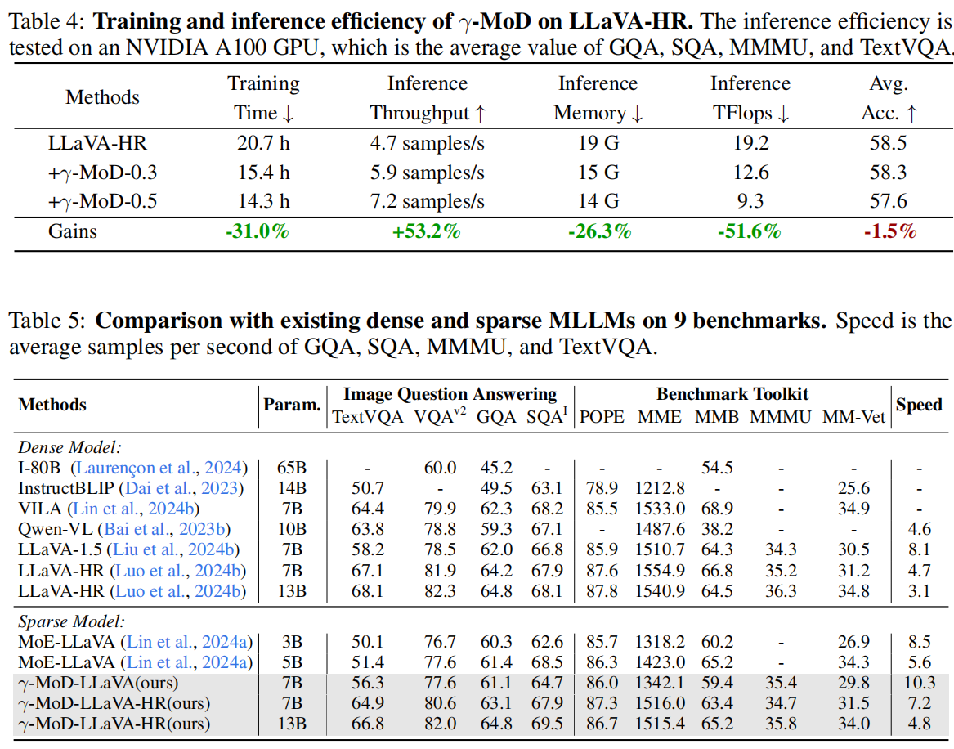
γ−MOD
Results

Slide 11
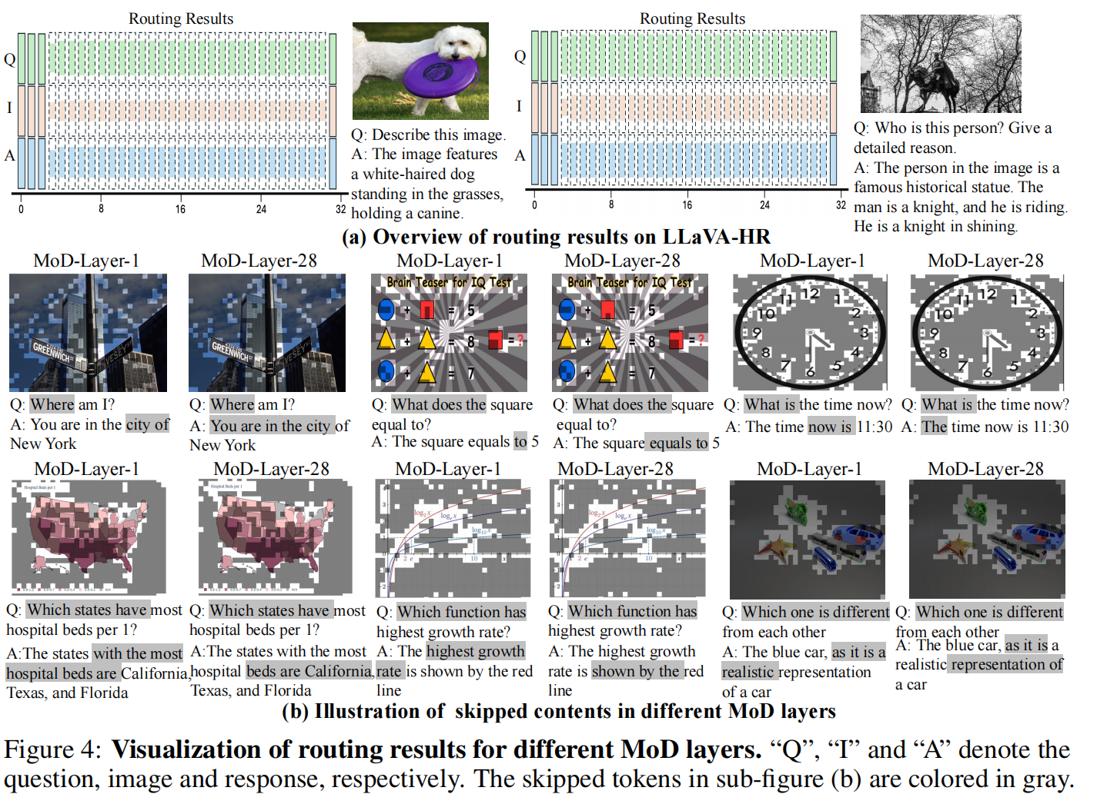
γ−MOD
Results

